Slide 1

Gravity Assist Assignment
Day 2: 1202 Program Alarm

Slide 2
Part 1:
This scenario involves an Intcode computer executing programs comprised of integers separated by commas.
Each program starts with an opcode indicating the operation to perform: 1 for addition, 2 for multiplication, and 99 to halt the program.
After the opcode, three integers follow: the positions of two inputs and the position where the result should be stored.
After processing an opcode, the program moves forward by 4 positions.
To illustrate, consider the program 1,9,10,3,2,3,11,0,99,30,40,50:
The first opcode is 1 (addition), with inputs at positions 9 and 10, and the result stored at position 3.
The values at positions 9 and 10 are retrieved (30 and 40), added together (resulting in 70), and stored at position 3.
The program then moves forward 4 positions to reach the next opcode.
The process continues until the program encounters opcode 99, which halts the program.
The goal is to determine the value left at position 0 after executing a given program with specific modifications:
Replace position 1 with the value 12 and position 2 with the value 2 before running the program.
Upon executing the modified program, the value left at position 0 after halting is the puzzle answer, which is 3895705.

Slide 3
Part 2:
In this scenario, to complete the gravity assist, the goal is to determine which pair of inputs produces a specific output (19690720).
Inputs are provided to the program by replacing values at addresses 1 and 2; these values are referred to as the noun and verb respectively.
Each input value (noun and verb) ranges from 0 to 99, inclusive.
After running the program, the output is available at address 0.
To find the correct noun and verb pair, reset the computer's memory to the initial program values for each attempt.
The objective is to discover the input noun and verb that result in the program producing the desired output.
Finally, the answer is obtained by calculating 100 * noun + verb.
The puzzle answer for the provided scenario is 6417 with noun as 64 and verb as 17.

Slide 4
Solution with python:
'gravityassistintcode.py' consists of the main python code.
We used two functions 'gravityassist_intcode' and 'find_input_for_output' to define Part 1 and Part 2 of the challenge respectively.
'gravityassist_intcode' does the addition and multiplication logic along with the code break when the halt opcode appears.
'find_input_for_output' does the does the search for the 2 inputs for a particular output(19690720) as provided in the challenge.
We have used for loops to iterate between integers and introduced error handling to catch errors.
We have used 'variables.py' to replace values in the code to avoid hardcoding in the actual code.
After the main code ran OK, we use the 'test_intcode.py' to perform unit test cases.
We have provided few test cases which passes if proper inputs are provided and comes as passed successfully.
We have put the whole solution as part of devops in a CI/CD pipeline using GITHUB actions.
'gravityassistpython.yml' is used as a yaml file where instructions are given to run the whole program on any push or commit is done in the GIT repoesitory.
The CI pipeline will first perform the main execution and then perform unit tests.
We can see the outputs in the pipeline workflow.

Slide 5
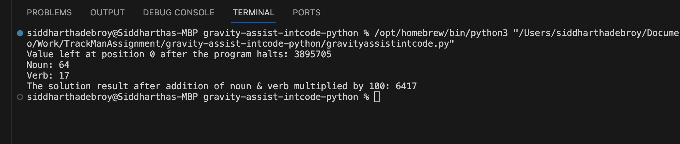
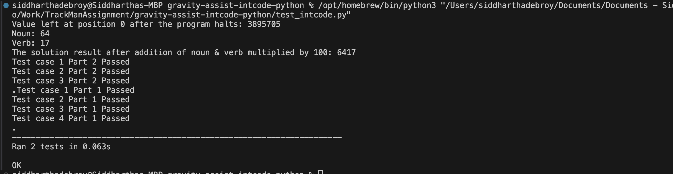
Screenshots- Running the code locally:

Slide 6
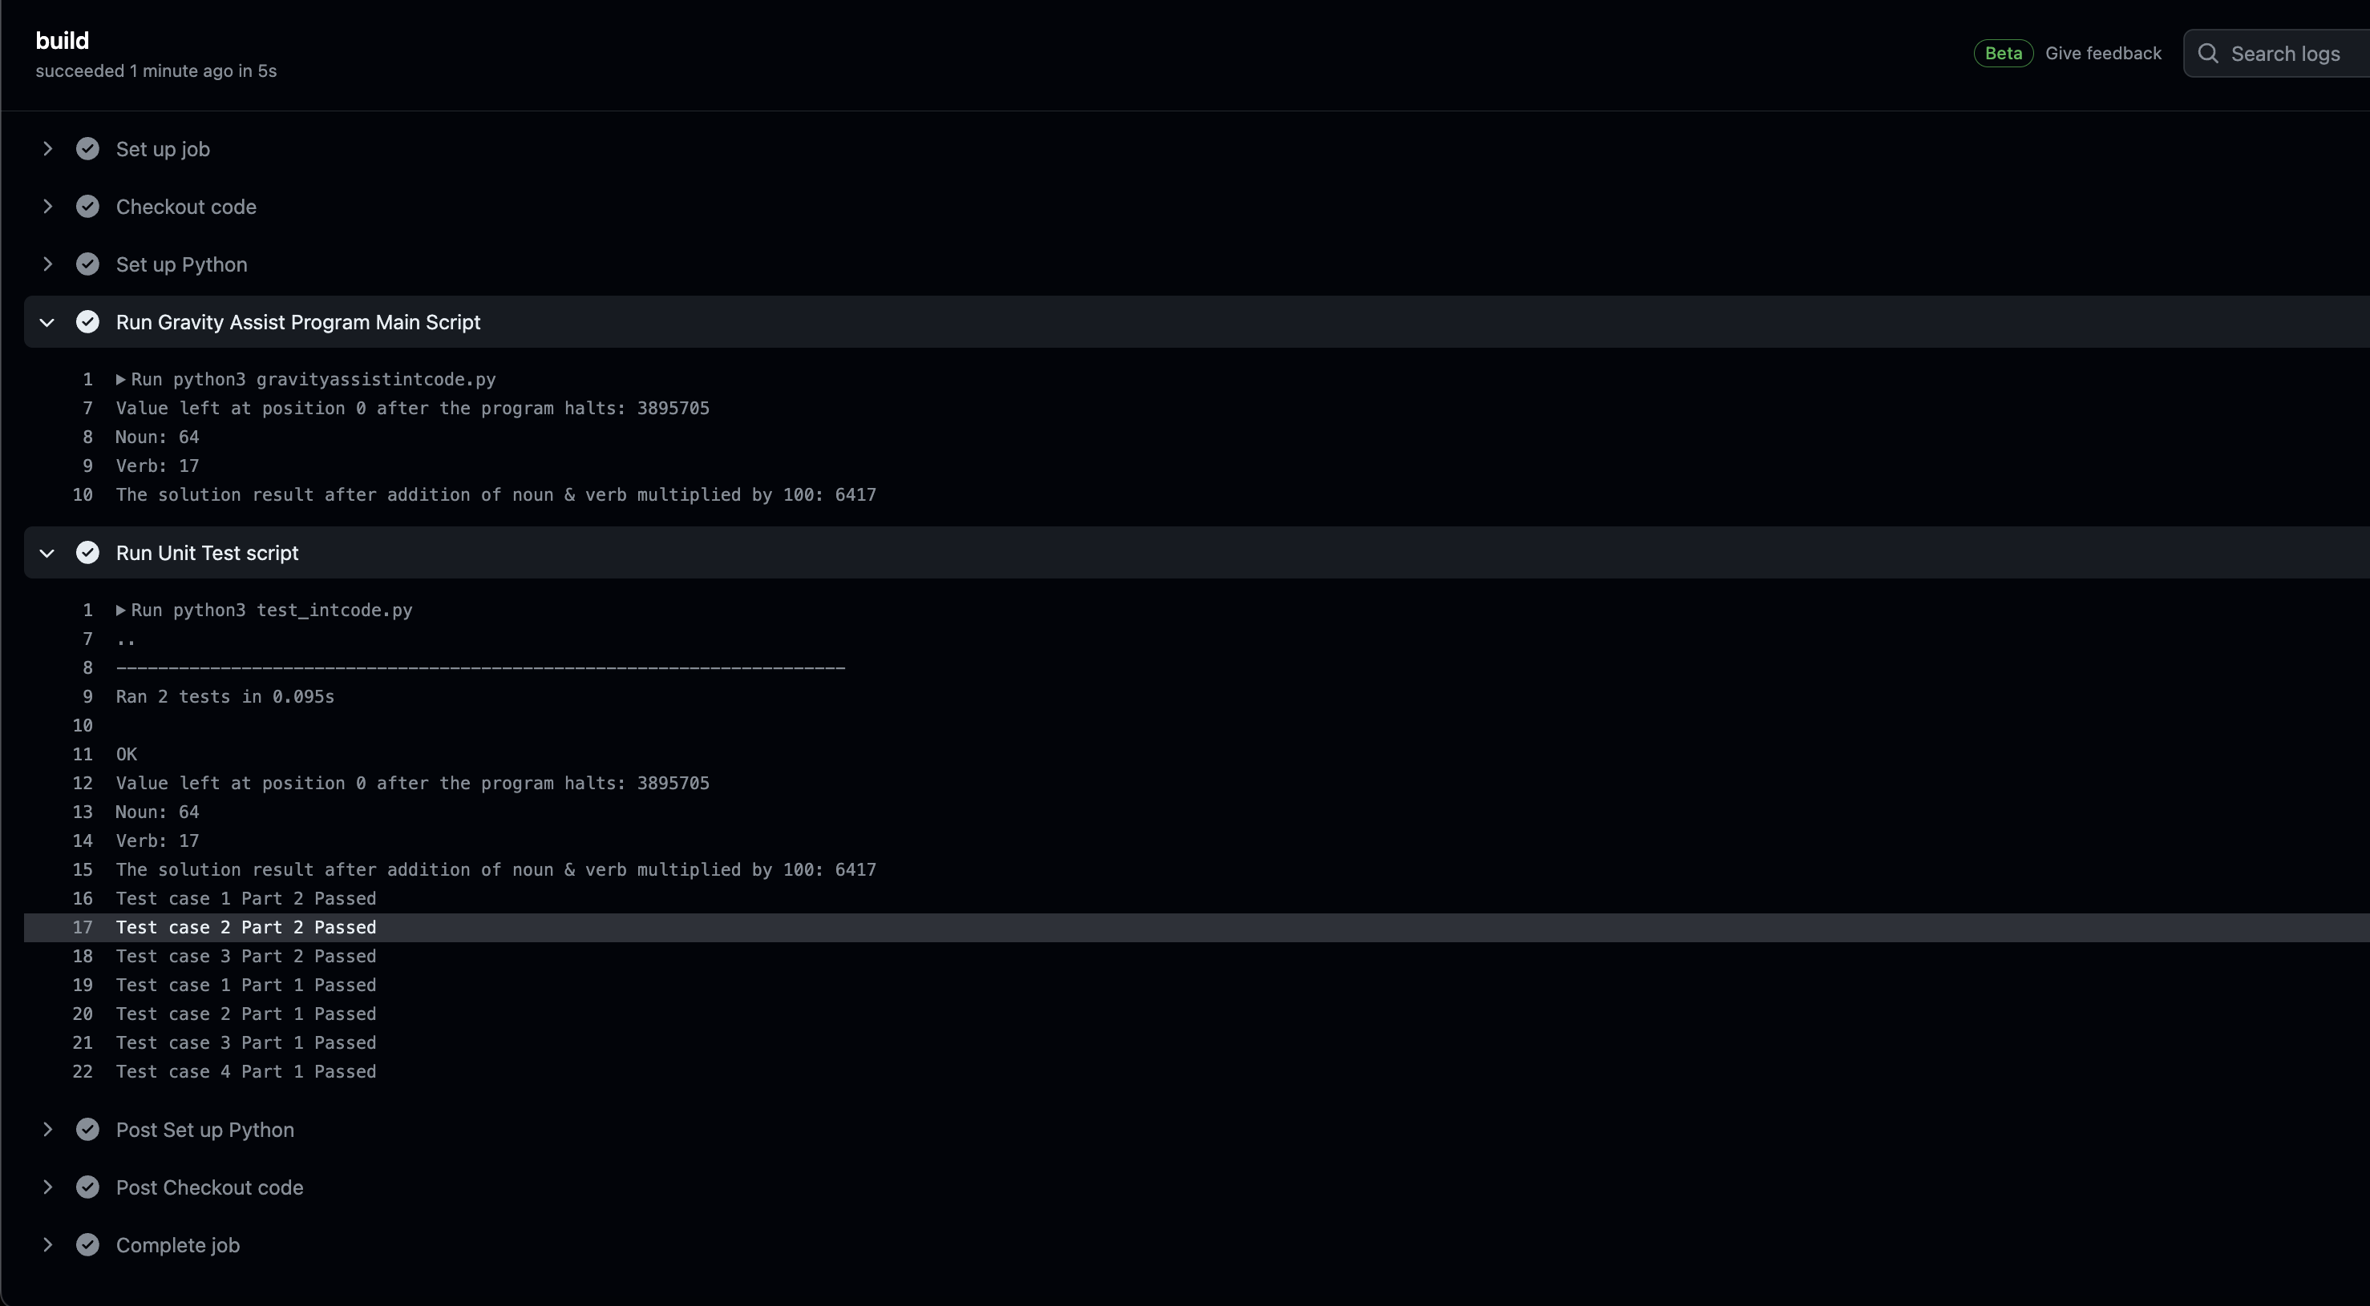
Screenshots- Running with CI Pipeline GITHUB Actions:

Slide 7
GITHUB Link:
https://github.com/siddhartha313/gravity-assist-intcode-python.git

Slide 8
THANK YOU

